Slide 1
Success Stories: Deepening Connections Between Food Hero and School Meals Sara Wilson Wolfe, MS, RDN, and Elaine Schrumpf, MS, OSU Extension Service Crista Hawkins, RDN, LD, and Erin Hirte, RDN, LD, Oregon Dairy and Nutrition Council
Notes:
Food Hero is a social marketing campaign to encourage and provide resources for low-income families to increase their fruit and vegetable intake. Development started in 2008 based on focus groups and phone interviews with over 2000 low-income moms. They chose the name and told us they prefer to receive information online, through friends and family and from magazines.

Slide 2
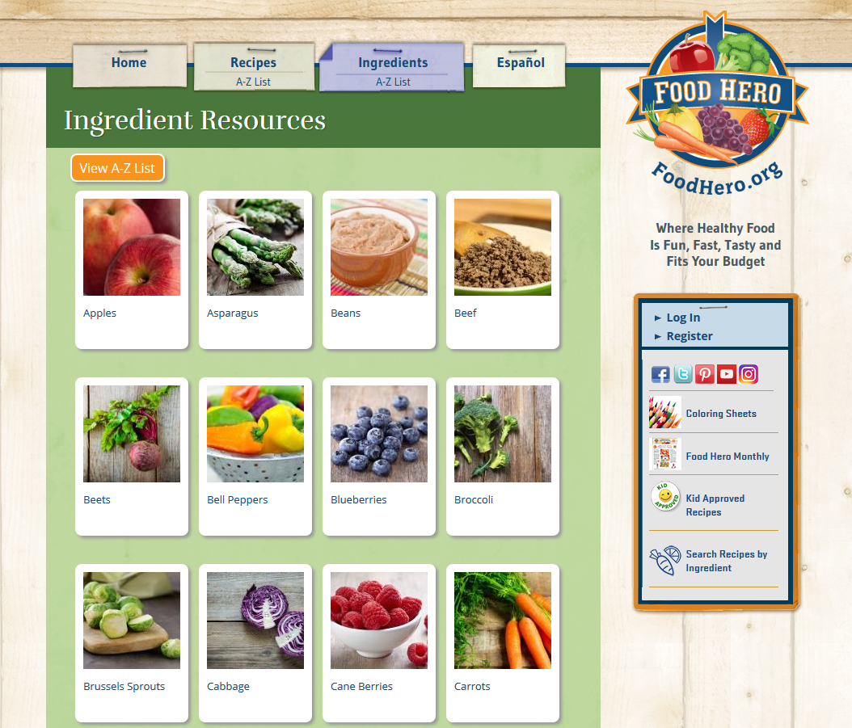
Ingredient Resources
Notes:
All of our resources are accessible through our website FoodHero.org. They are organized by focus ingredients – primarily fruits and vegetables. As you can see, there is quite a variety including posters, a monthly magazine, coloring sheets, hand stamps and more.

Slide 3
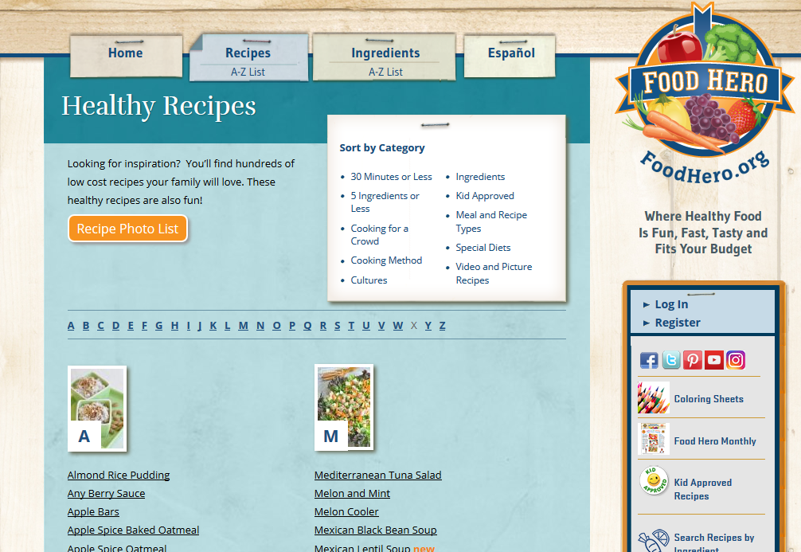
Family Sized Recipes
Easy to prepare, tested recipes
Use low cost, common ingredients
Meet our nutritional criteria
Notes:
The most popular resource is easy, low cost, healthy, tested recipes that taste good. We have approximately 350 recipes. They all meet our nutritional criteria to limit calories from fat, limit sodium levels, and provide good nutrient density.

Slide 4
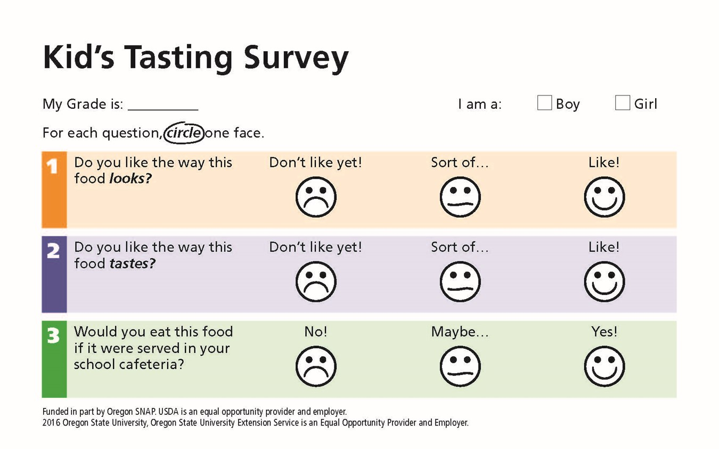
Kid’s Tasting Survey
Notes:
Since our SNAP-Ed program has educators in every county in Oregon, many of our recipes have been taste tested with kids. The kids can vote by survey or a ‘counting chip’. The survey asks if they like the look, like the taste, and if they would eat this food if it were served in their school cafeteria. To date we have received surveys or counting chip data from over 60,000 kids.

Slide 5
Kid Approved
Notes:
If 70% or more of the kids ‘like’ the taste of the recipe, it is tagged ‘Kid Approved’. Currently we have 95 Kid Approved recipes. We used this designation as part of the criteria in selecting which recipes might be increased to Quantity Recipes for school meals.

Slide 6
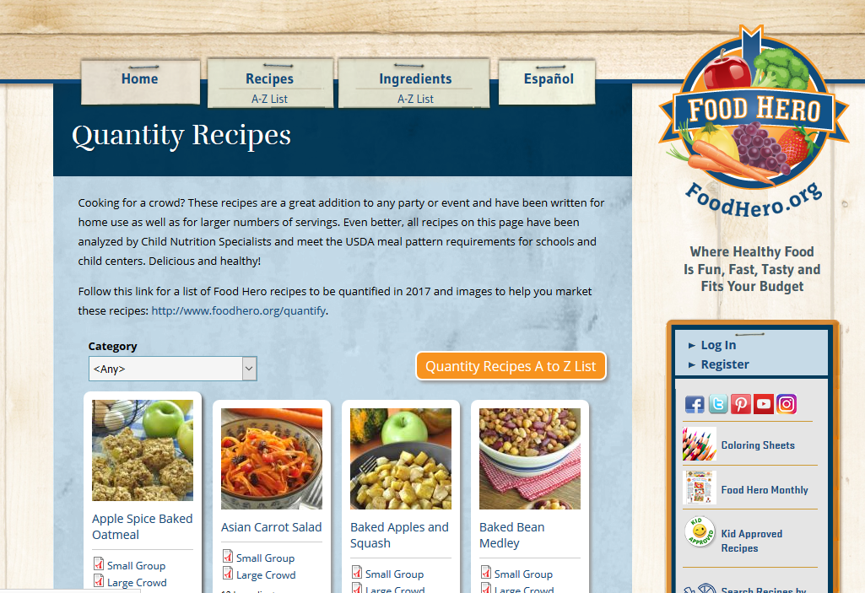
Quantity Recipes
70+ quantified recipes
Analyzed by Child Nutrition Specialists to meet the USDA meal pattern requirements for schools and child centers
Notes:
Quantity versions of some of our recipes were developed through a partnership with ODE Child Nutrition Services. About 70 Food Hero recipes have been quantified at four quantity levels and credited for federal reimbursement.

Slide 7
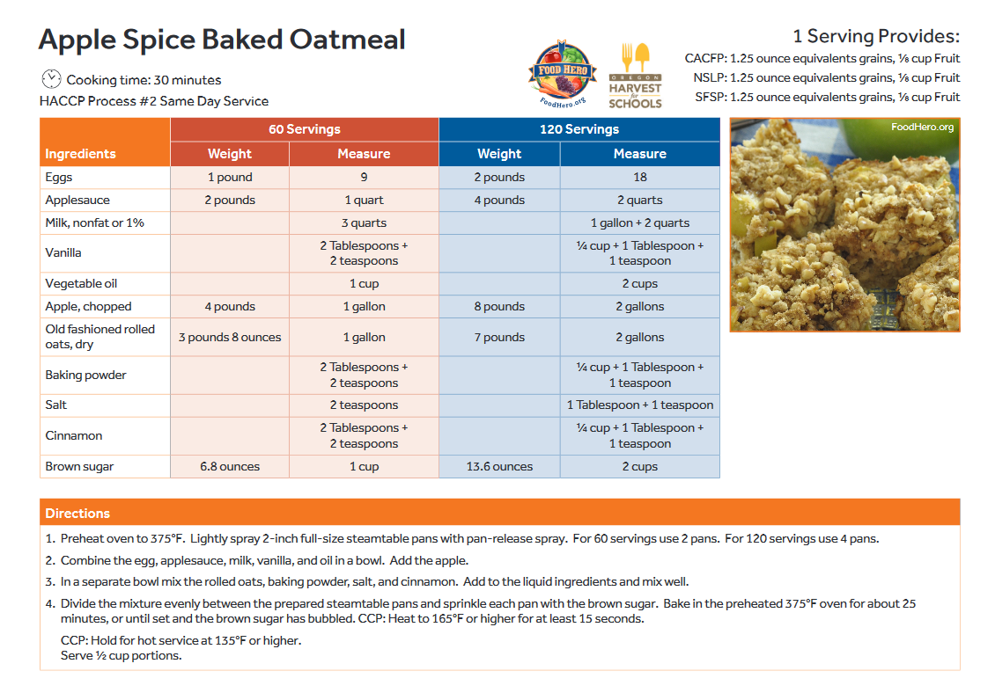
Notes:
Having family sized and quantity recipes can enhance the link between what a child might eat at home and at school. By working together, we can increase the familiarity to fruits and vegetables and eventually the consumption.

Slide 8
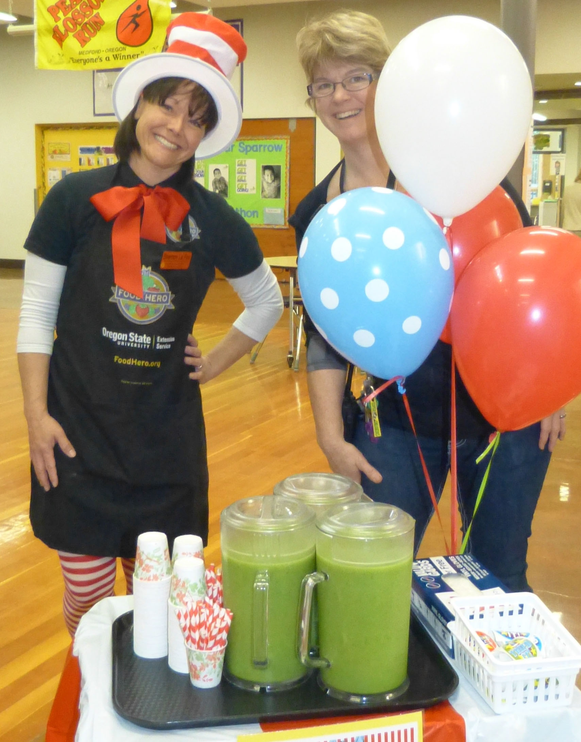
Roosevelt Elementary Grants Pass
Special Event Food Hero Popeye Smoothie Tasting
Notes:
We’d like to share a few ways that Food Hero and School Food Service are working together.
At schools that are part of our county programming, our educators may be able to conduct Tastings. These can be either in the classroom or in the cafeteria.

Slide 9
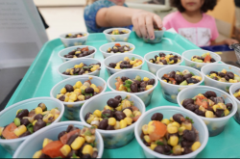
Try It Tuesday – Food Hero Cowboy Salad
Bethel School District
Notes:
If the Kids Tasting survey or counting chips are used, educators can share the results with Food Service in hopes that it goes on the lunch line.

Slide 10
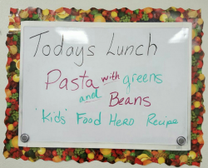
Special School Lunch for the Iron Chef winning recipe
Notes:
Food Service might prepare a recipe from a school-wide Food Hero Event. In this case it was an Iron Chef contest where the kids prepared some Food Hero recipes while learning the basics of food preparation.

Slide 11
Healthy Celebrations - in the classroom or at school-wide events
Notes:
Food Service might also join with Food Hero to promote Healthy Celebrations in classrooms or school events.

Slide 12
Bethel School District Menu – Food Hero Barley, Bean and Corn Salad
Family sized recipe uses the Oregon Harvest featured food
Notes:
Including a Food Hero family sized recipe on the menu can support the link to Oregon Harvest for Schools.

Slide 13
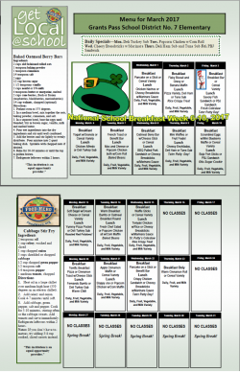
Family sized recipe links school lunch and home meals
Food Hero Baked Berry Oatmeal Bar
Food Hero Cabbage Stir Fry
Grants Pass School District
Notes:
When the same food is available at home and at school, acceptance may increase.

Slide 14
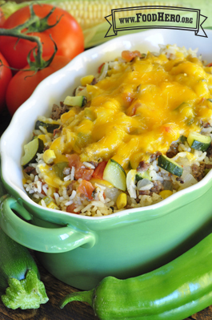
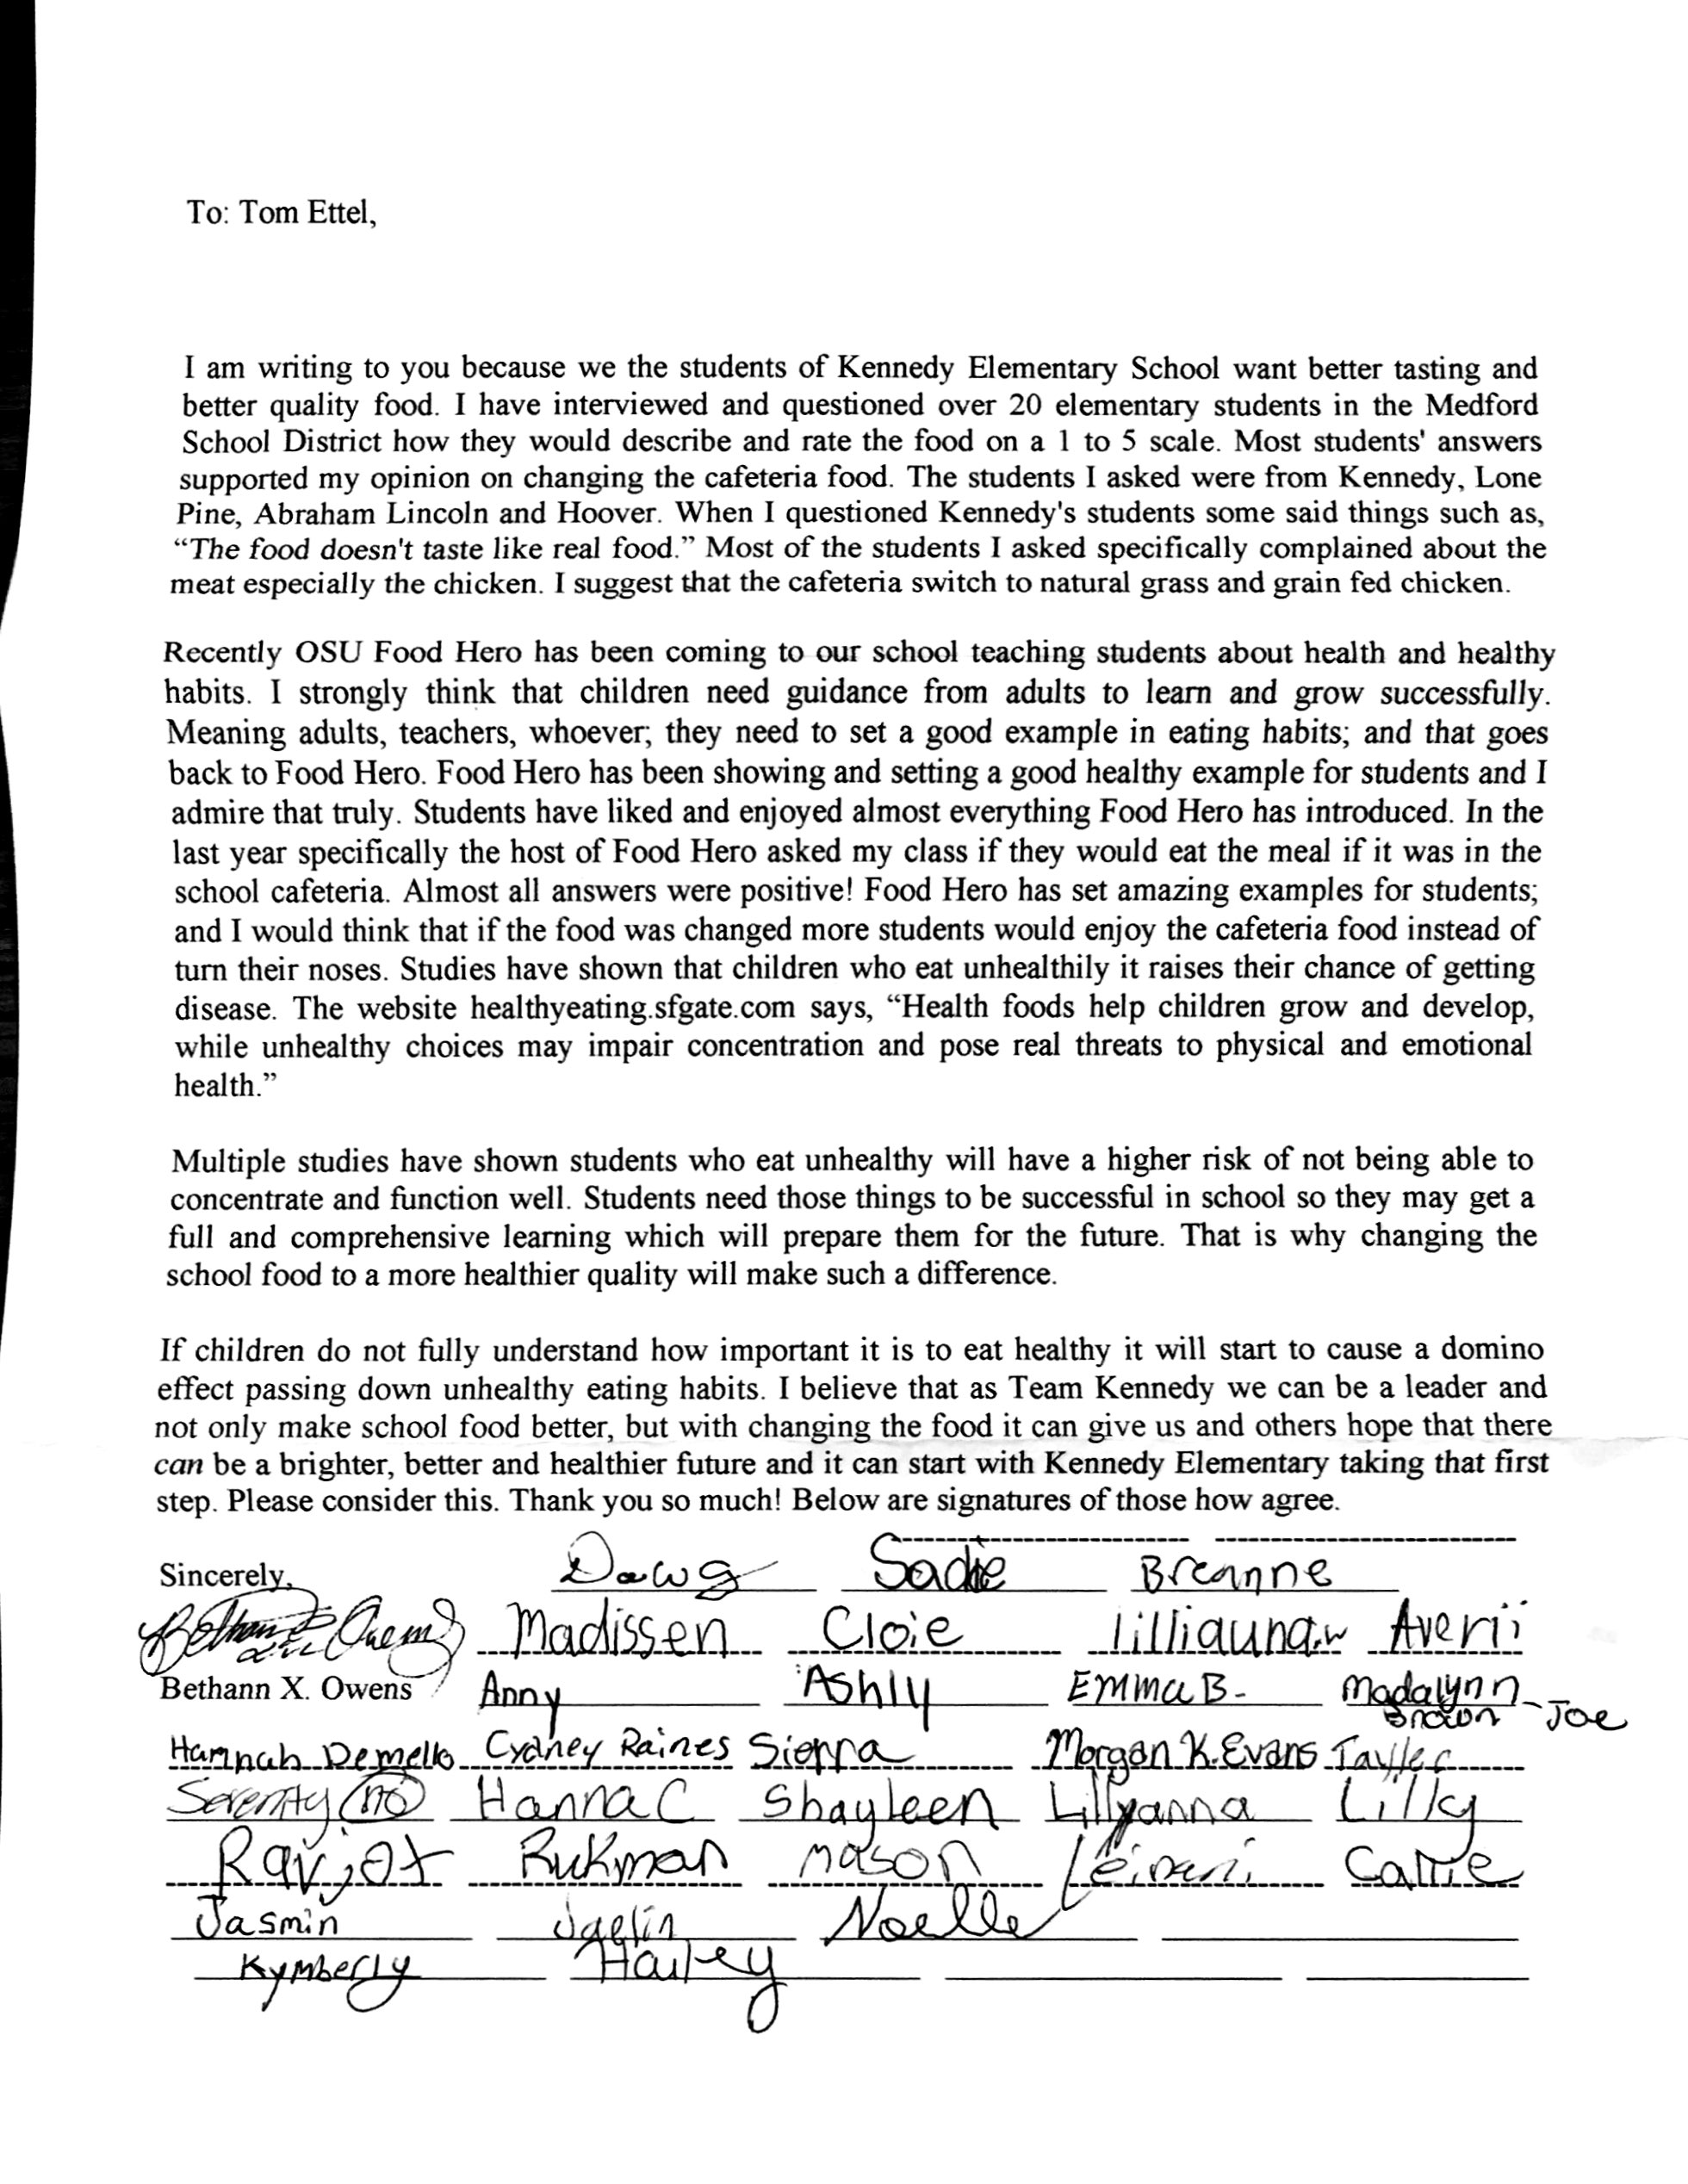
Mexican Vegetable and Beef Skillet Meal
Kennedy Elementary
Medford
Notes:
Occasionally the tastings result in a Food Hero recipe being added to the menu items. Students at Kennedy Elementary wrote a letter citing the positive responses students had to Food Hero series of tastings and asked for changes in the school lunch menu. rotation. Their principal and Food Service director helped move the request forward and as a result, Mexican Vegetable and Beef Skillet Meal, was added to their lunch rotation by Sodexo.

Slide 15
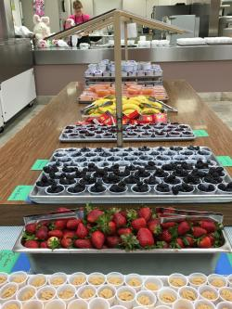
Lincoln Elementary School
Grants Pass
Oatmeal Bar

Slide 16
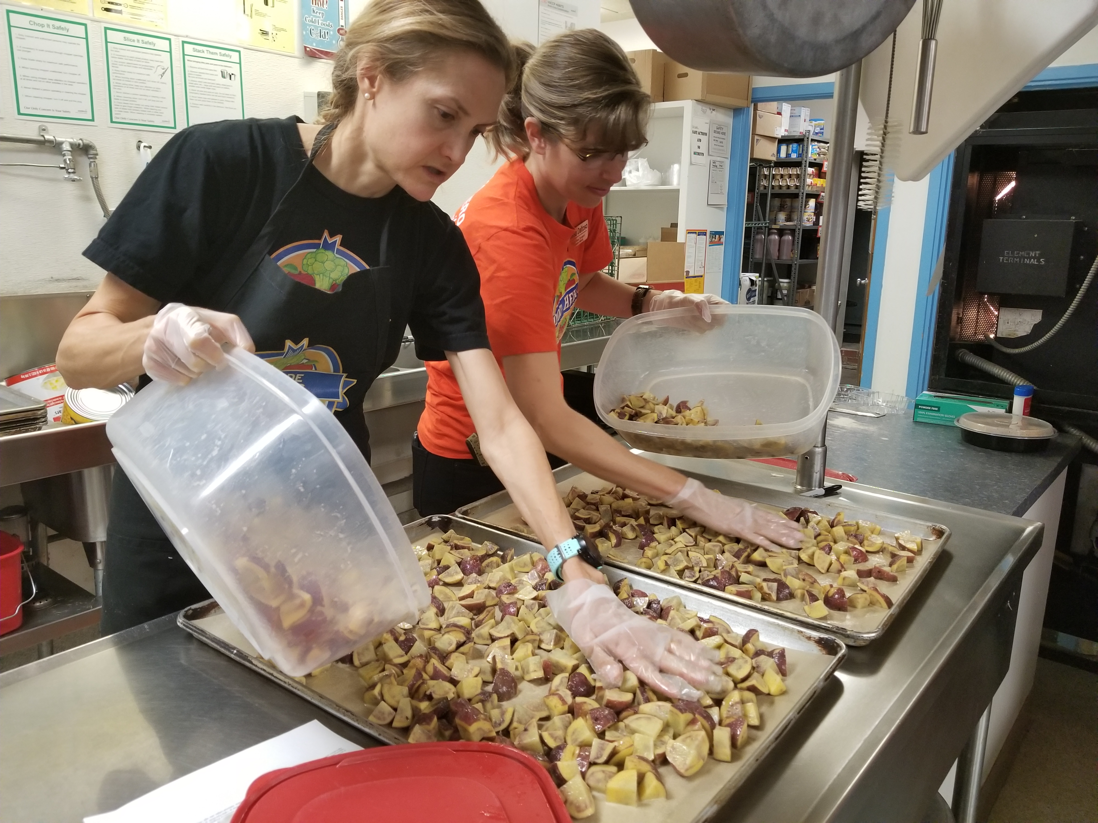
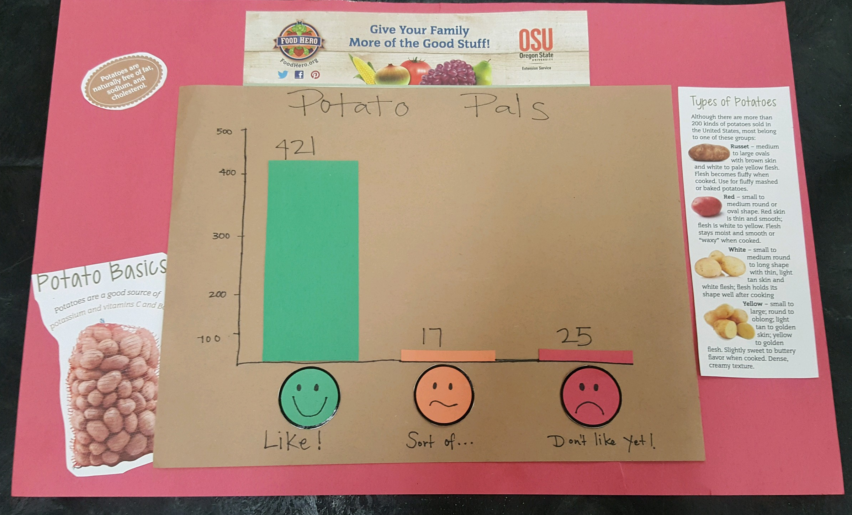
Preparing Food Hero Potato Pals
Umatilla
Potato Pals Kids Tasting Survey results

Slide 17
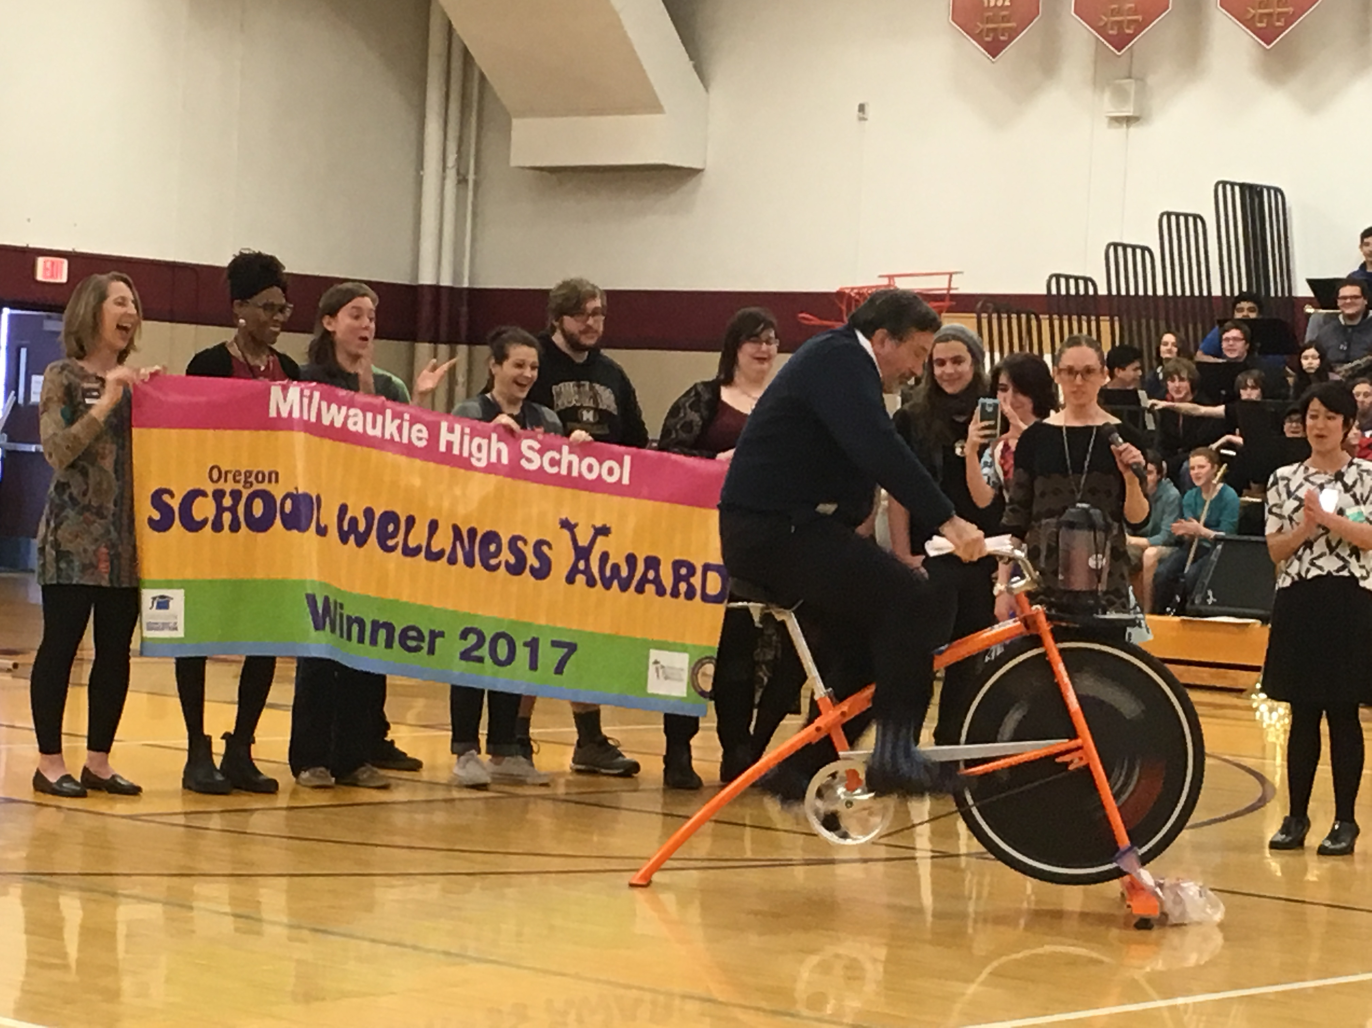
Blender Bike
Umatilla
Milwaukie
High School
Notes:
Blender Bike – Umatilla
Milwaukie High School principal riding the Bike Blender at the ODE School Wellness Award Assembly

Slide 18
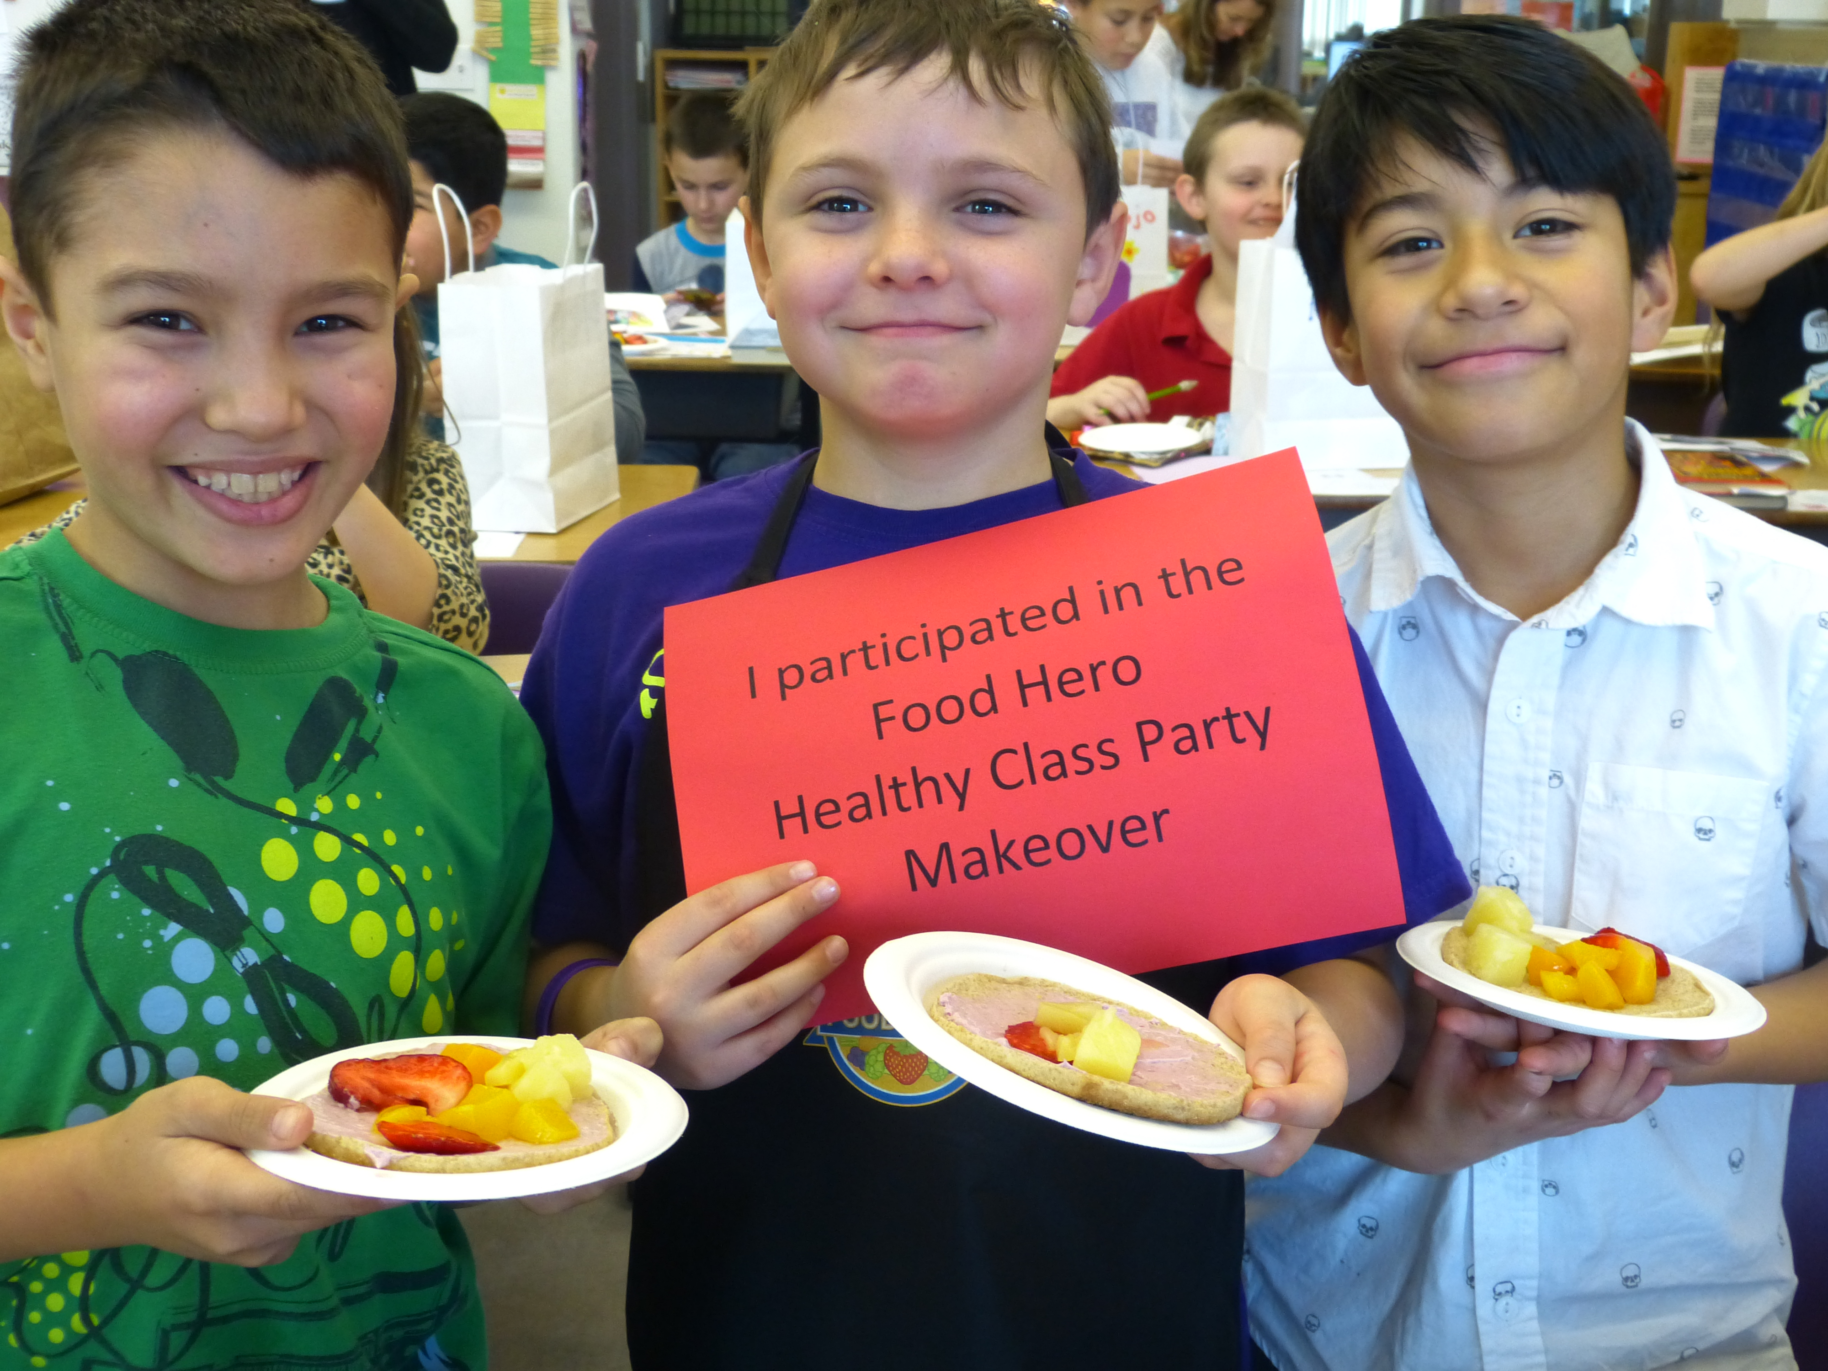
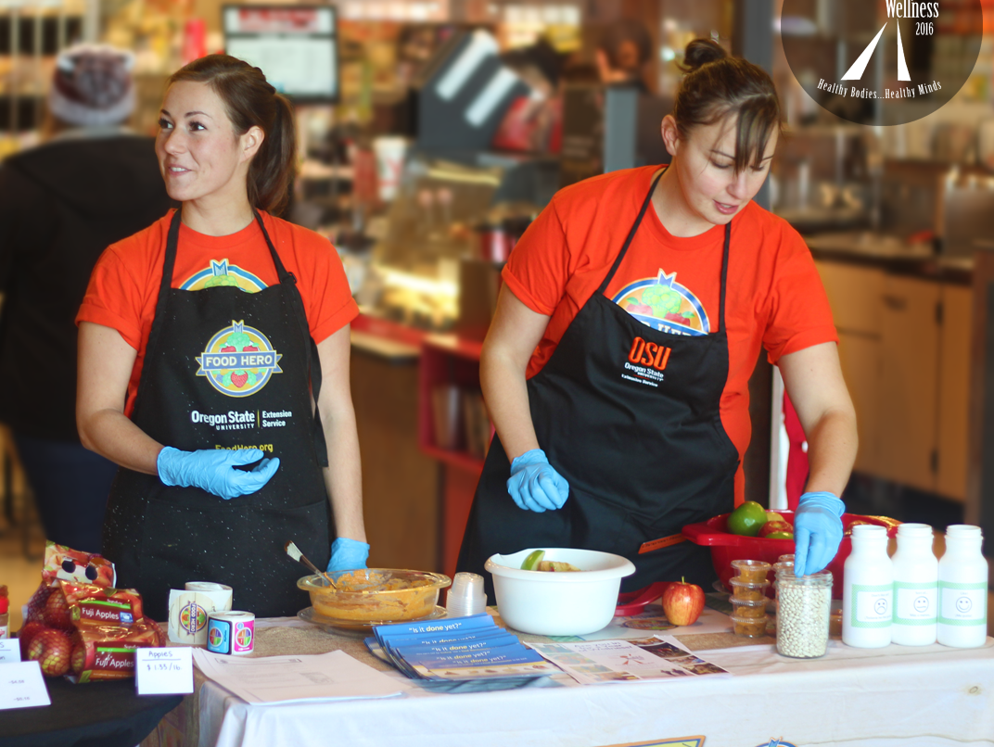
Questions?
Email: Food.Hero@oregonstate.edu
Notes:
We hope the quantity recipes will make it easier to link with Food Hero.

